Slide 1
Mining Data Descriptive Characteristics
Motivation
  To better understand the data: central tendency, variation and spread
Data dispersion characteristics
  median, max, min, quantiles, outliers, variance, etc.
Numerical dimensions correspond to sorted intervals
  Data dispersion: analyzed with multiple granularities of precision
  Boxplot or quantile analysis on sorted intervals
Dispersion analysis on computed measures
  Folding measures into numerical dimensions
  Boxplot or quantile analysis on the transformed cube
ITE-404 - Data Warehousing and Data Mining

Slide 2
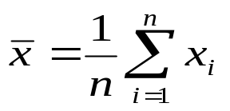

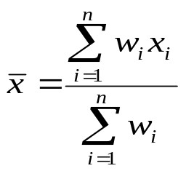
Measuring the Central Tendency
Mean (algebraic measure) (sample vs. population):
  Weighted arithmetic mean:
  Trimmed mean: chopping extreme values
Median: A holistic measure
  Middle value if odd number of values, or average of the middle two values otherwise
  Estimated by interpolation (for grouped data):
Mode
  Value that occurs most frequently in the data
  Unimodal, bimodal, trimodal
  Empirical formula:
ITE-404 - Data Warehousing and Data Mining

Slide 3



Symmetric vs. Skewed Data
Median, mean and mode of symmetric, positively and negatively skewed data
ITE-404 - Data Warehousing and Data Mining

Slide 4

Mean, median, mode, and range
Find the mean, median, mode, and range for the following list of values:
13, 18, 13, 14, 13, 16, 14, 21, 13
The mean is the usual average, so:
(13 + 18 + 13 + 14 + 13 + 16 + 14 + 21 + 13) ÷ 9 = 15
The median is the middle value, so I'll have to rewrite the list in order:
13, 13, 13, 13, 14, 14, 16, 18, 21
There are nine numbers in the list, so the middle one will be the 5th number:
13, 13, 13, 13, 14, 14, 16, 18, 21 So the median is 14.
The mode is the number that is repeated more often than any other, so 13 is the mode.
The largest value in the list is 21, and the smallest is 13, so the range is 21 – 13 = 8.
mean: 15 median: 14 mode: 13 range: 8
ITE-404 - Data Warehousing and Data Mining

Slide 5


Measuring the Dispersion of data
We define the variance to be
and the standard deviation to be
ITE-404 - Data Warehousing and Data Mining

Slide 6
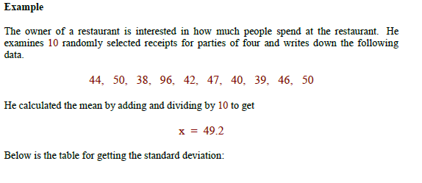
Contd….
ITE-404 - Data Warehousing and Data Mining

Slide 7
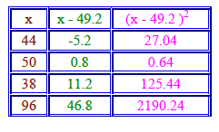
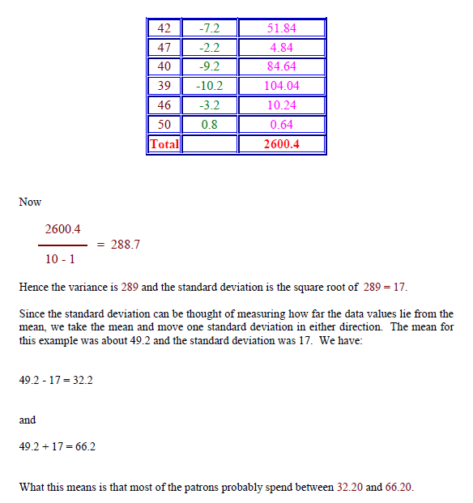
Contd….
ITE-404 - Data Warehousing and Data Mining

Slide 8
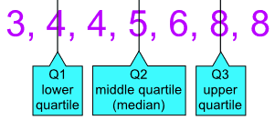
Quartiles
Quartiles are the values that divide a list of numbers into quarters.
First put the list of numbers in order
Then cut the list into four equal parts
The Quartiles are at the "cuts"
Example: 5, 8, 4, 4, 6, 3, 8
Put them in order: 3, 4, 4, 5, 6, 8, 8
Cut the list into quarters:
And the result is:
Quartile 1 (Q1) = 4
Quartile 2 (Q2), which is also the Median, = 5
Quartile 3 (Q3) = 8
ITE-404 - Data Warehousing and Data Mining

Slide 9
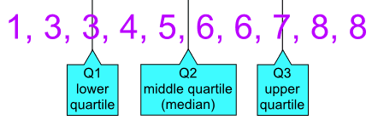
Contd….
Sometimes a "cut" is between two numbers ... the Quartile is the average of the two numbers.
Example: 1, 3, 3, 4, 5, 6, 6, 7, 8, 8
The numbers are already in order
Cut the list into quarters:
In this case Quartile 2 is half way between 5 and 6:
Q2 = (5+6)/2 = 5.5
And the result is:
Quartile 1 (Q1) = 3
Quartile 2 (Q2) = 5.5
Quartile 3 (Q3) = 7
ITE-404 - Data Warehousing and Data Mining

Slide 10
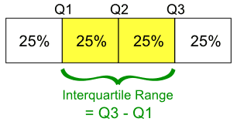
Interquartile Range
The "Interquartile Range" is from Q1 to Q3:
To calculate it just subtract Quartile 1 from Quartile 3, like this:
Example:
The Interquartile Range is:
Q3 - Q1 = 8 - 4 = 4
ITE-404 - Data Warehousing and Data Mining

Slide 11
five-number summary
The of a distribution consists of the
median (Q2), the quartiles Q1 and Q3, and the smallest and largest individual observations,
written in the order of Minimum, Q1, Median, Q3, Maximum.
Boxplots are a popular way of visualizing a distribution. A boxplot incorporates the
five-number summary as follows:
Typically, the ends of the box are at the quartiles so that the box length is the
interquartile range.
The median is marked by a line within the box.
Two lines (called whiskers) outside the box extend to the smallest (Minimum) and
largest (Maximum) observations.
ITE-404 - Data Warehousing and Data Mining

Slide 12
Box and Whisker Plot and Interquartile Range
Example: 4, 17, 7, 14, 18, 12, 3, 16, 10, 4, 4, 11
Put them in order:
3, 4, 4, 4, 7, 10, 11, 12, 14, 16, 17, 18
Cut it into quarters:
3, 4, 4 | 4, 7, 10 | 11, 12, 14 | 16, 17, 18
In this case all the quartiles are between numbers:
Quartile 1 (Q1) = (4+4)/2 = 4
Quartile 2 (Q2) = (10+11)/2 = 10.5
Quartile 3 (Q3) = (14+16)/2 = 15
The Lowest Value is 3,
The Highest Value is 18
ITE-404 - Data Warehousing and Data Mining

Slide 13

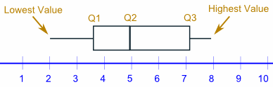
Contd….
So now we have enough data for the Box and Whisker Plot:
(3, 4, 4 | 4, 7, 10) | (11, 12, 14 | 16, 17, 18)
Quartile 1 (Q1) = (4+4)/2 = 4
Quartile 2 (Q2) = (10+11)/2 = 10.5
Quartile 3 (Q3) = (14+16)/2 = 15
And the Interquartile Range is:
Q3 - Q1 = 15 - 4 = 11
ITE-404 - Data Warehousing and Data Mining

Slide 14
Probability and statistics: Interquartile range (IQR)
Step 1: Put the numbers in order
1,2,5,6,7,9,12,15,18,19,27
Step 2: Find the median (How to find a median)
1,2,5,6,7,9,12,15,18,19,27
Step 3: Place parentheses around the numbers above and below the median.
Not necessary statistically–but it makes Q1 and Q3 easier to spot.
(1,2,5,6,7),9,(12,15,18,19,27)
Step 4: Find Q1 and Q3
Q1 can be thought of as a median in the lower half of the data, and Q3 can be thought of as a median for the upper half of data.
(1,2,5,6,7), 9, ( 12,15,18,19,27). Q1=5 and Q3=18.
Step 5: Subtract Q1 from Q3 to find the interquartile range.
18-5=13.
ITE-404 - Data Warehousing and Data Mining

Slide 15
Contd….
Sample question: Find the IQR for the following data set:
3, 5, 7, 8, 9, 11, 15, 16, 20, 21
Step 1: Put the numbers in order
3, 5, 7, 8, 9, 11, 15, 16, 20, 21
Step 2: Make a mark in the center of the data:
3, 5, 7, 8, 9, | 11, 15, 16, 20, 21
Step 3: Place parentheses around the numbers above and below the mark you made in Step 2 –it makes Q1 and Q3 easier to spot.
(3, 5, 7, 8, 9), | (11, 15, 16, 20, 21)
Step 4: Find Q1 and Q3
Q1 is the median (the middle) of the lower half of the data, and Q3 is the median (the middle) of the upper half of the data.
(3, 5, 7, 8, 9), | (11, 15, 16, 20, 21). Q1 = 7 and Q3 = 16.
Step 5: Subtract Q1 from Q3.
16 – 7 = 9.
This is your IQR.
ITE-404 - Data Warehousing and Data Mining

Slide 16

Outlier
"Outliers" are values that "lie outside" the other values.
When we collect data, sometimes there are values that are "far away" from the main group of data ...
Steps
Learn how to recognize a potential outlier.
Arrange the data points from lowest to highest.
Calculate the median of the data set.
Calculate the lower quartile.
Calculate the upper quartile.
Find the outliers (It will be any points below or above)
ITE-404 - Data Warehousing and Data Mining

Slide 17
Contd….
Find the outliers, if any, for the following data set:
(10.2, 14.1, 14.4. 14.4, 14.4, 14.5, 14.5, 14.6, 14.7, 14.7, 14.7, 14.9, 15.1, 15.9, 16.4)
Q1 Q2
(10.2, 14.1, 14.4. 14.4, 14.4, 14.5, 14.5,) 14.6,
Q3
(14.7, 14.7, 14.7, 14.9, 15.1, 15.9, 16.4)
To find out if there are any outliers, I first have to find the IQR. There are fifteen data points, so the median will be at position (15 + 1) ÷ 2 = 8. Then Q₂ = 14.6. There are seven data points on either side of the median, so Q₁ is the fourth value in the list and Q₃ is the twelfth: Q₁ = 14.4 and Q₃ = 14.9. Then IQR = 14.9 – 14.4 = 0.5.
Outliers will be any points below Q₁ – 1.5×IQR = 14.4 – 0.75 = 13.65 or above Q₃ + 1.5×IQR = 14.9 + 0.75 = 15.65.
Then the outliers are at 10.2, 15.9, and 16.4.
ITE-404 - Data Warehousing and Data Mining
Notes:
To do this in a boxplot, the whiskers are extended to the
extreme low and high observations only if these values are less than 1.5IQR beyond
the quartiles.Otherwise, the whiskers terminate at the most extreme observations occurring
within 1.5IQR of the quartiles.

Slide 18
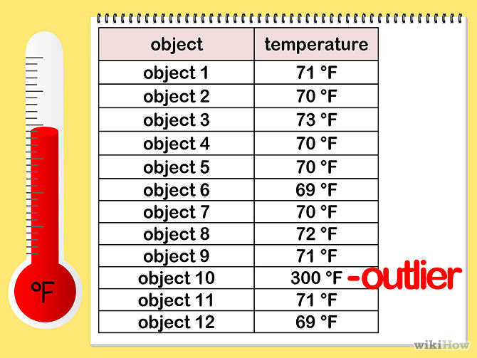
Contd….
ITE-404 - Data Warehousing and Data Mining

Slide 19
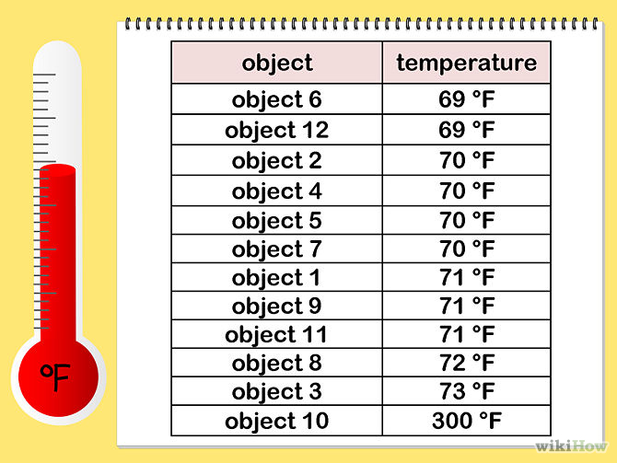
Contd….
ITE-404 - Data Warehousing and Data Mining

Slide 20
Contd….
Calculate the median of the data set
the middle 2 terms are 70 and 71, so the median is ((70 + 71) / 2), or 70.5.
ITE-404 - Data Warehousing and Data Mining

Slide 21
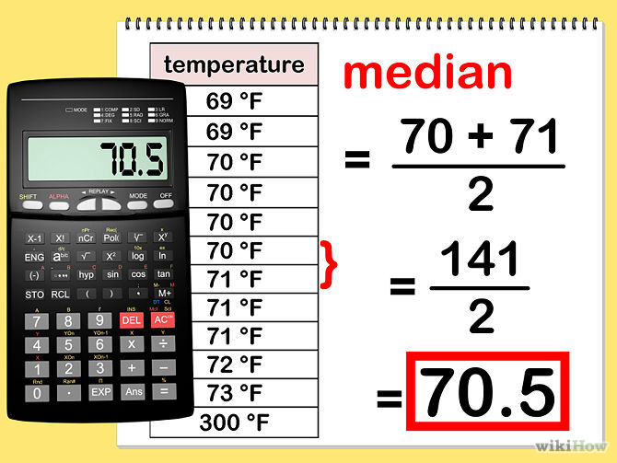
Contd….
ITE-404 - Data Warehousing and Data Mining

Slide 22
Contd….
Q1 Q2 Q3
{69, 69, 70 | 70, 70, 70} | {71, 71, 71 | 72, 73, 300}
ITE-404 - Data Warehousing and Data Mining

Slide 23
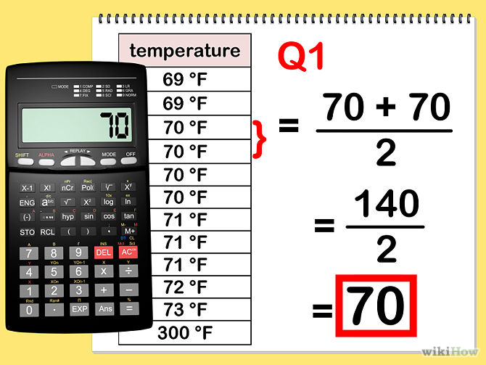
Contd….
ITE-404 - Data Warehousing and Data Mining

Slide 24
Contd….
Q1 Q2 Q3
{69, 69, 70 | 70, 70, 70} | {71, 71, 71 | 72, 73, 300}
ITE-404 - Data Warehousing and Data Mining

Slide 25
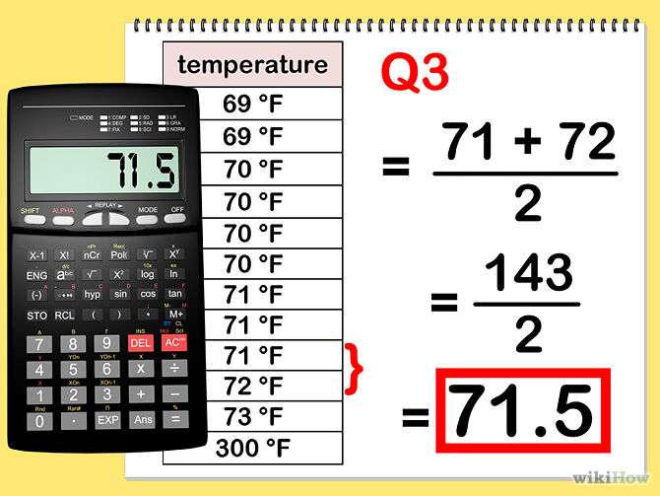
Contd….
ITE-404 - Data Warehousing and Data Mining

Slide 26
Contd….
The first step is to multiply the difference between Q1 and Q3 (called the interquartile range) by 1.5.
In the example above, the interquartile range is (71.5 - 70), or 1.5. Multiplying this by 1.5 yields 2.25.
Add this number to Q3 and subtract it from Q1 to construct the inner fences.
The inner fences in this example would be 67.75 and 73.75.
Any data points that lie outside this range are considered mild outliers. In the data set in this example, only the temperature of the oven - 300 degrees - is considered a mild outlier.
ITE-404 - Data Warehousing and Data Mining

Slide 27
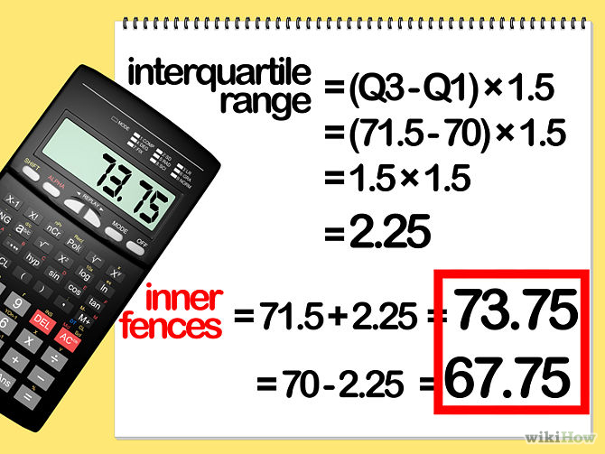
Contd….
ITE-404 - Data Warehousing and Data Mining

Slide 28
Contd….
This is done in the same way as the inner fences, except the interquartile range is multiplied by 3 instead of 1.5.
Multiplying the interquartile range above by 3 yields (1.5 * 3), or 4.5.
The outer fences are therefore 65.5 and 76.
Any data points that lie outside the outer fences are considered extreme outliers. In this example, the oven temperature, 300 degrees, is also considered an extreme outlier.
ITE-404 - Data Warehousing and Data Mining

Slide 29
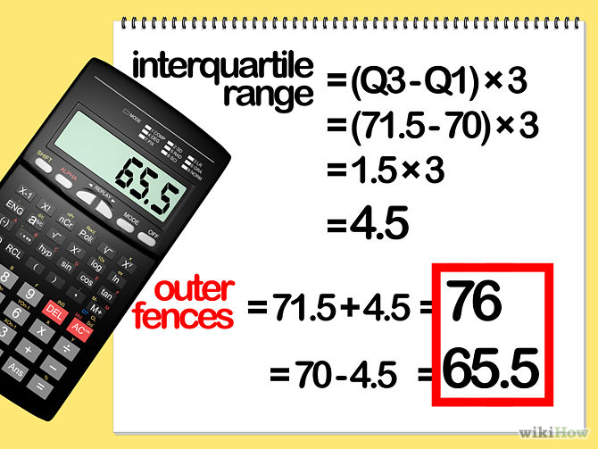
Contd….
ITE-404 - Data Warehousing and Data Mining

Slide 30


Measuring the Dispersion of Data
Quartiles, outliers and boxplots
  Quartiles: Q₁ (25th percentile), Q₃ (75th percentile)
  Inter-quartile range: IQR = Q₃ – Q₁
  Five number summary: min, Q₁, M, Q₃, max
  Boxplot: ends of the box are the quartiles, median is marked, whiskers, and plot outlier individually
  Outlier: usually, a value higher/lower than 1.5 x IQR
Variance and standard deviation (sample: s, population: σ)
  Variance: (algebraic, scalable computation)
  Standard deviation s (or σ) is the square root of variance s² ⁽or σ²⁾
ITE-404 - Data Warehousing and Data Mining

Slide 31
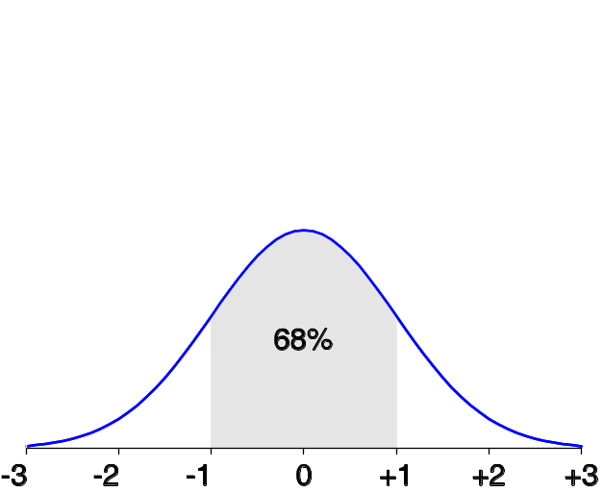
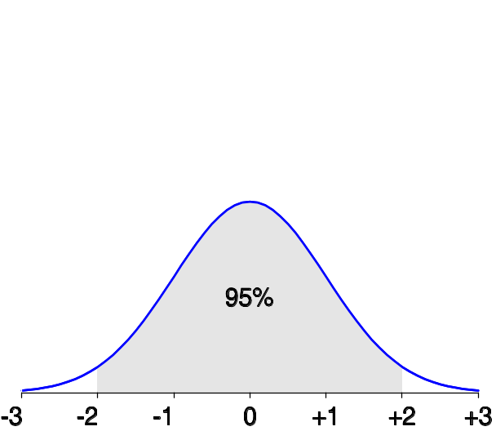
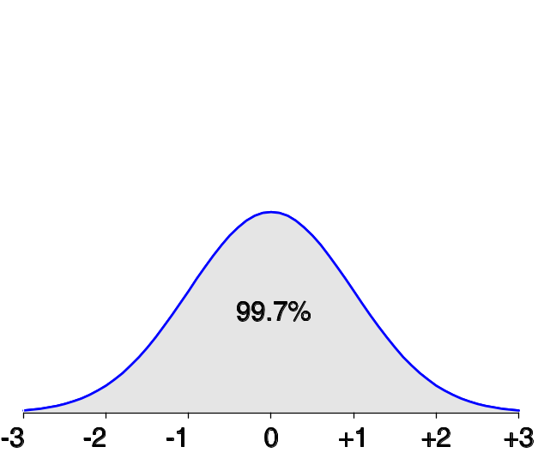
Properties of Normal Distribution Curve
The normal (distribution) curve
  From μ–σ to μ+σ: contains about 68% of the measurements (μ: mean, σ: standard deviation)
  From μ–2σ to μ+2σ: contains about 95% of it
  From μ–3σ to μ+3σ: contains about 99.7% of it
ITE-404 - Data Warehousing and Data Mining

Slide 32

Boxplot Analysis
Five-number summary of a distribution:
  Minimum, Q1, M, Q3, Maximum
Boxplot
  Data is represented with a box
  The ends of the box are at the first and third quartiles, i.e., the height of the box is IRQ
  The median is marked by a line within the box
  Whiskers: two lines outside the box extend to Minimum and Maximum
ITE-404 - Data Warehousing and Data Mining

Slide 33

Visualization of Data Dispersion: Boxplot Analysis
ITE-404 - Data Warehousing and Data Mining

Slide 34

Histogram Analysis
Graph displays of basic statistical class descriptions
  Frequency histograms
    A univariate graphical method
    Consists of a set of rectangles that reflect the counts or frequencies of the classes present in the given data
ITE-404 - Data Warehousing and Data Mining

Slide 35
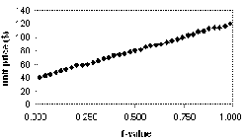
Quantile Plot
Displays all of the data (allowing the user to assess both the overall behavior and unusual occurrences)
Plots quantile information
  For a data x_{i} data sorted in increasing order, f_{i} indicates that approximately 100 f_{i}% of the data are below or equal to the value x_{i}
ITE-404 - Data Warehousing and Data Mining

Slide 36
Quantile-Quantile (Q-Q) Plot
Quantile-Quantile Plot (Q-Q Plot) is a graphical method for diagnosing differences between the probability distribution and the sampling distribution.
Graphs the quantiles of one univariate distribution against the corresponding quantiles of another
Allows the user to view whether there is a shift in going from one distribution to another
ITE-404 - Data Warehousing and Data Mining

Slide 37
Q-Q plot: example
The height data
Construct 40 pairs of quantiles
(-1.21, 59), (-0.63, 61), (-1.78, 55), …, (2.24, 70)
Plot the pairs on a two-coordinate system
  x-axis: theoretical (distribution) quantiles
  y-axis: sample quantiles
ITE-404 - Data Warehousing and Data Mining

Slide 38
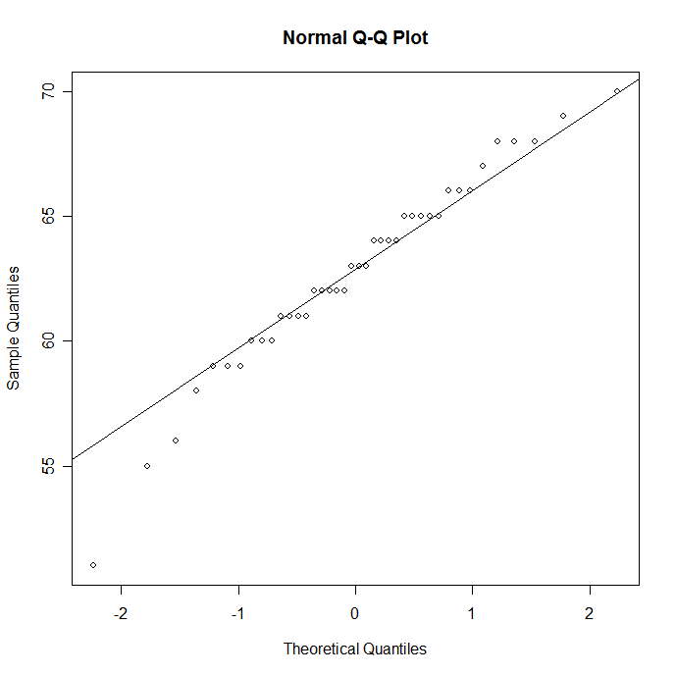
Q-Q Plot for Height Data
ITE-404 - Data Warehousing and Data Mining

Slide 39
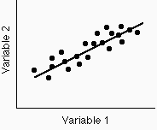
Scatter plot
used to study and identify the possible relationship between the changes observed in two different sets of variables.
A set of bivariate (data with two variables) graphed as ordered pairs in a coordinate plane is called a scatter plot.
Provides a first look at bivariate data to see clusters of points, outliers, etc
Each pair of values is treated as a pair of coordinates and plotted as points in the plane
ITE-404 - Data Warehousing and Data Mining

Slide 40
Correlation
The relationship between two variables is called their correlation .
ITE-404 - Data Warehousing and Data Mining

Slide 41
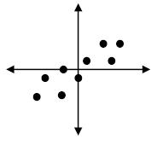
Positive Correlation
If the data points make a straight line going from the origin out to high x- and y-values, then the variables are said to have a positive correlation
ITE-404 - Data Warehousing and Data Mining

Slide 42
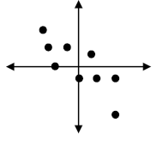
Negative Correlation
If the line goes from a high-value on the y-axis down to a high-value on the x-axis, the variables have a negative correlation .
ITE-404 - Data Warehousing and Data Mining

Slide 43
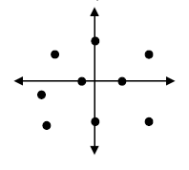
No Correlation
If the plot on the graph is scattered in such a way that it does not approximate a line (it does not appear to rise or fall), there is no correlation between the sets of data.
ITE-404 - Data Warehousing and Data Mining

Slide 44
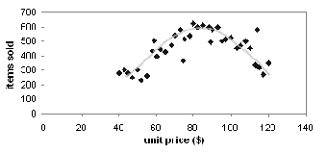
Loess Curve
Adds a smooth curve to a scatter plot in order to provide better perception of the pattern of dependence
Loess curve is fitted by setting two parameters: a smoothing parameter, and the degree of the polynomials that are fitted by the regression
ITE-404 - Data Warehousing and Data Mining

Slide 45


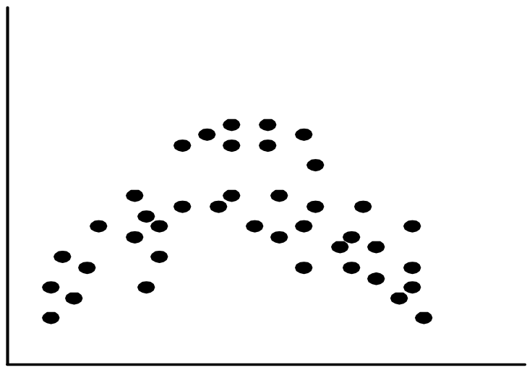
Positively and Negatively Correlated Data
ITE-404 - Data Warehousing and Data Mining

Slide 46


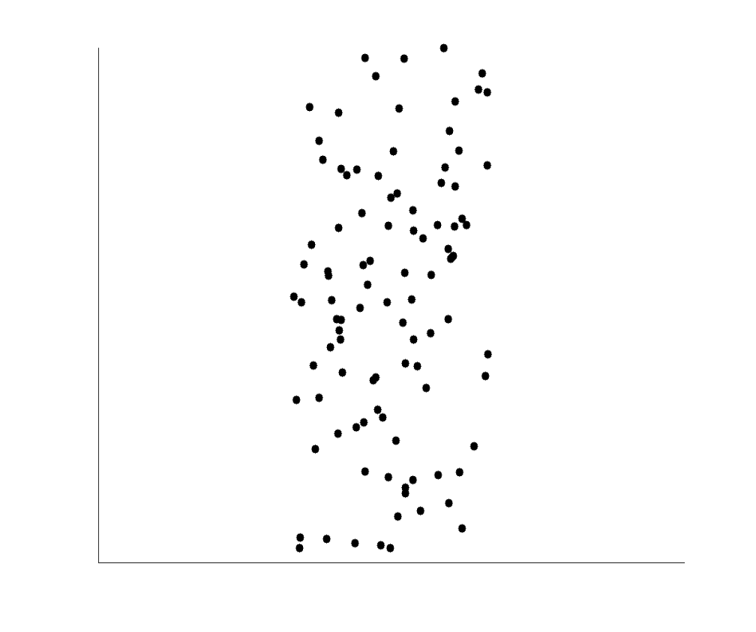
Not Correlated Data
ITE-404 - Data Warehousing and Data Mining

